Slide 1
Analysis of the COVID-19 policy responses using Machine Learning
Hugues Nelson Iradukunda
DATA 606 Capstone Project
Prof. Chaojie (Jay) Wang

Slide 2
Introduction
Since March 2020, COVID-19 was declared as a global pandemic.
As of today, the infections have reached more than half of billion cases, and the death toll is about 6 millions worldwide.
Several restrictions were imposed by countries to minimize the infections rates.
The goal of this study is to use machine learning model with a focus to understand the effectiveness of the governmental policy responses based on the latest COVID-19 data.

Slide 3
Who is interested?
Policy and decision-makers around the world to understand the effects of lockdown measures.
Citizens to understand how governments are working in terms of fighting against COVID-19 in a consistent way.
From the government perspective, being able to predict the confirmed cases is the key to assess what policy responses have been effective throughout the pandemic.

Slide 4
Research Questions/Hypotheses
Have restrictions contributed to minimizing COVID-19 daily infections over the past 2 years?
Are all the collected data regarding the policy responses statistically significant in predicting the confirmed cases?
What are the main policy responses drivers in predicting the confirmed cases?

Slide 5
Data Sources
The timeseries data from COVID-19 policy tracker presented by the Oxford COVID-19 Government Response Tracker (OxCGRT).
The OxCGRT systematically collects information on common policy responses governments taken.
The OxCGRT records these policies on a scale to reflect the extent of government action, and it aggregates these scores into a suite of policy indices all over 187 countries worldwide.
This dataset includes the daily number of reported COVID-19 confirmed cases in each country. These data are collected by the Center for Systems Science and Engineering (CSSE) at Johns Hopkins University.

Slide 6
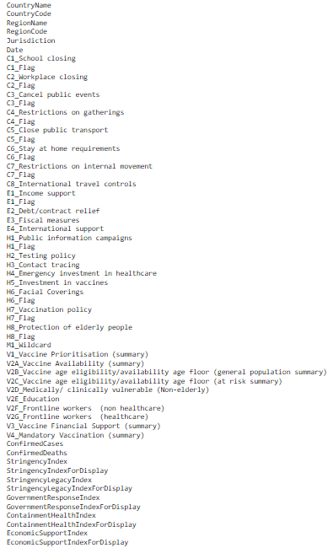
Data Features

Slide 7
Understanding the Data Features
The different COVID-19 policy responses are coded into indicators, such as public places closures, travel restrictions, testing and vaccinations.
They are grouped into 5 categories:
C: containment and closure policies
E: economic policies
H: health system policies
V: vaccination policies
M: miscellaneous indicator.
There is a Stringency Index where a higher score indicates a stricter government response (i.e. 100 = strictest response).

Slide 8
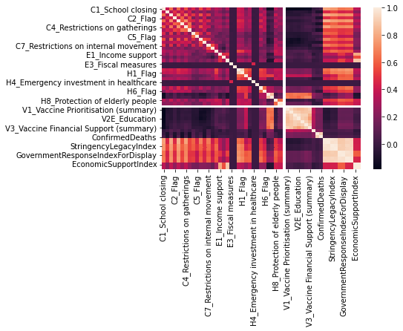
Heatmap for data correlation
Obviously, the stringency index is correlated with the government policy responses used in this dataset, such as public events cancelation, school closing, and other restriction measures.
Notes:
Obviously, the stringency index is correlated with the government policy responses used in this dataset, such as public events cancelation, school closing, and other restriction measures.

Slide 9
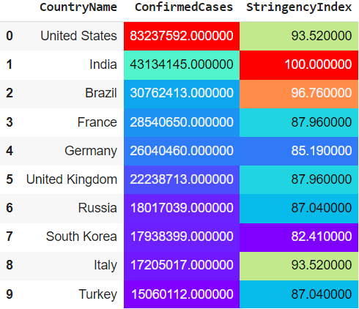
Countries with highest COVID-19 Cases and their highest recorded Stringency Index.
A higher level of stringency index does not necessarily mean that a country's response is better in fighting with COVID than those with lower stringency index.
It's just an indication of how a country is strict when it comes to responding to COVID.

Slide 10
Target vs. Predictors for Regression Modeling
Target: ConfirmedCases.
Predictors variables: all remaining attributes, except string objects type representing countries names and codes which are excluded from the set.
Date is also dropped from our model training set.
ConfirmedDeaths is correlated to ConfirmedCases, so it is not necessary for our model since we are looking to study the COVID-19 policy responses.

Slide 11
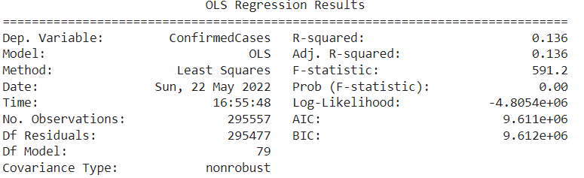
Ordinary Least-Squares (OLS) Model Results
The OLS Regression Model has 𝑅² = 0.136 , so our model is capturing around 14% of the variance in ConfirmedCases.

Slide 12
OLS Model Results
According to the OLS Model results:
Most of the attributes in this dataset are statistically significant except:
C6_Flag, E4_International support, H5_Investment in vaccines, M1_Wildcard, V2D_Medically/ clinically vulnerable (Non-elderly),StringencyIndexForDisplay, StringencyLegacyIndex, V2B_Vaccine age eligibility/availability age floor (general population summary)_30-34 yrs, V2B_Vaccine age eligibility/availability age floor (general population summary)_50-54 yrs, V2B_Vaccine age eligibility/availability age floor (general population summary)_65-69 yrs, V2B_Vaccine age eligibility/availability age floor (general population summary)_70-74 yrs, V2C_Vaccine age eligibility/availability age floor (at risk summary)_30-34 yrs, V2C_Vaccine age eligibility/availability age floor (at risk summary)_50-54 yrs, V2C_Vaccine age eligibility/availability age floor (at risk summary)_60-64 yrs, V2C_Vaccine age eligibility/availability age floor (at risk summary)_70-74 yrs, V2C_Vaccine age eligibility/availability age floor (at risk summary)_75-79 yrs, V2C_Vaccine age eligibility/availability age floor (at risk summary)_80+ yrs
Based on their significance level (P-value) greater than 0.05.

Slide 13
OLS Model Results
The strongest drivers of the ConfirmedCases predictions are:
H2_Testing policy,
V4_Mandatory Vaccination (summary),
H8_Protection of elderly people
because of their high t-statistics.

Slide 14
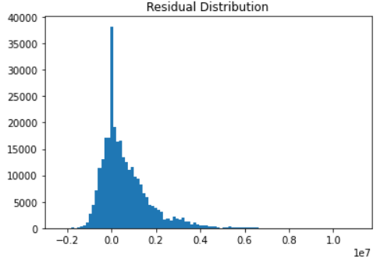
OLS Model – Residuals Evaluation
The residuals has a near-normal distribution.
Therefore, there is no concerns with the residuals with this OLS Regression Model.

Slide 15
Linear Regression Model Pipeline
The 80% of data is used for training and the rest 20% for testing.
Data preprocessing:
Standardization of numerical values,
Transformation of categorical variables into dummy variables.

Slide 16
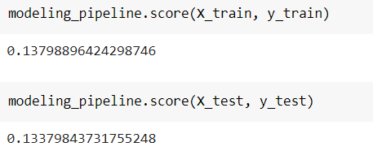
Linear Regression Model Evaluation
The 𝑅² scores for both training and testing sets are near 14%.
No indication of model overfitting.

Slide 17
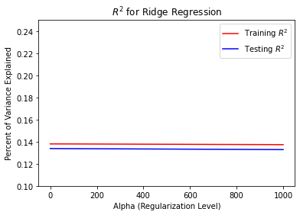
Ridge Regression for model regularization
The ridge regression term:
alpha = [0.001, 0.01, 0.1, 1, 10, 100, 1000]
𝑅² is still around 14% for both training and testing data sets.
Therefore, Ridge regression does not seem to change the model for the better fitting.

Slide 18
XGBoost for Regression Model
XGBoost is a gradient boosting algorithm. It provides parallel boosting trees algorithm that can solve Machine Learning tasks.
This XGBRegressor model is using 100 boosting trees (n_estimators=100).

Slide 19
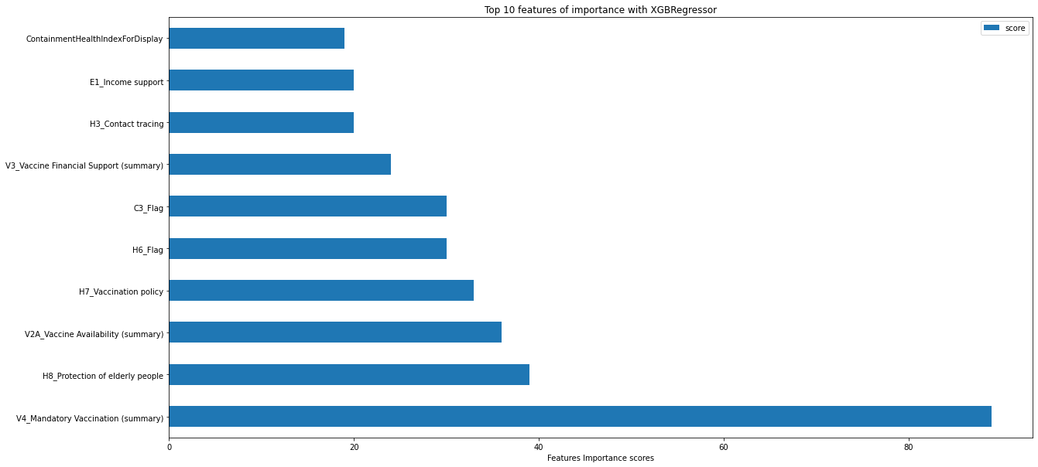
Top Features of Importance with XGBRegressor Model

Slide 20
Conclusions
Most of the policy responses contributed to reducing the daily number of coronavirus disease infection rates, especially in the early phase of the pandemic.
The stringency index was higher when the countries started imposing the lockdown measures to respond to the rise of daily COVID-19 confirmed cases.
Finally, the safety measures, such as mandatory vaccination, testing, and strengthening the immunization among the elders are critical to saving lives and recovering from COVID.

Slide 21
References
Oxford COVID-19 Government Response Tracker, Blavatnik School of Government, University of Oxford.
https://www.bsg.ox.ac.uk/research/research-projects/covid-19-government-response-tracker
https://github.com/OxCGRT/covid-policy-tracker
Python Machine Learning, 3rd Edition, Raschka and Mirjalili.

Slide 22


